Slide 1

Project Title – Airbnb Hotel Booking Data Analysis
[SAGAR SHENDE ]

Slide 2

PROBLEM STATEMENT
To analyze Airbnb booking data to identify key factors affecting price variations and availability in different neighbourhoods, helping hosts and customers make informed decisions.

Slide 3
Project Description [This project involves comprehensive analysis of Airbnb booking data to understand pricing trends, availability patterns, and the influence of location-based factors. Using Python libraries such as Pandas, NumPy, Matplotlib, and Seaborn, the dataset was cleaned by handling missing values, correcting inconsistent data, and removing outliers. The goal was to identify key insights related to room types, neighborhood popularity, review impact, and seasonal availability. This analysis helps hosts improve pricing strategies and assists users in making informed booking decisions.]

Slide 4

WHO ARE THE END USERS?
This project is primarily intended for Airbnb hosts and guests. Hosts can use the insights to optimize pricing and availability of their listings, while guests can find better options at reasonable prices. Additionally, market researchers and business analysts can leverage this data for trend analysis and decision-making.

Slide 5

Technology Used
This project uses Python programming language for data analysis and visualization. Key libraries such as Pandas and NumPy are used for data cleaning and processing. Matplotlib and Seaborn are utilized for graphical representation of data. The project is developed using Jupyter Notebook."

Slide 6
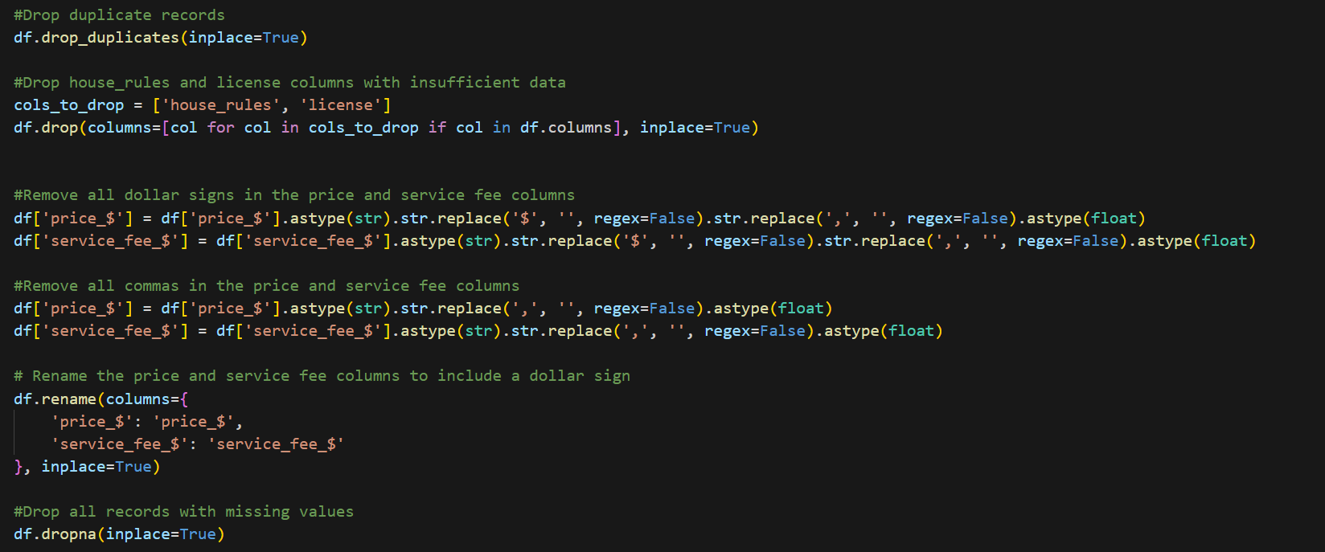
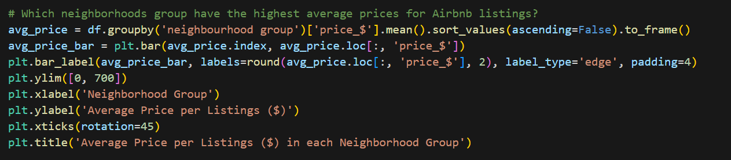
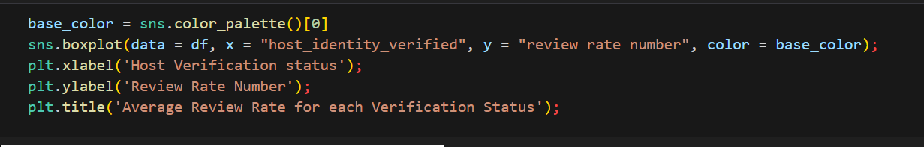
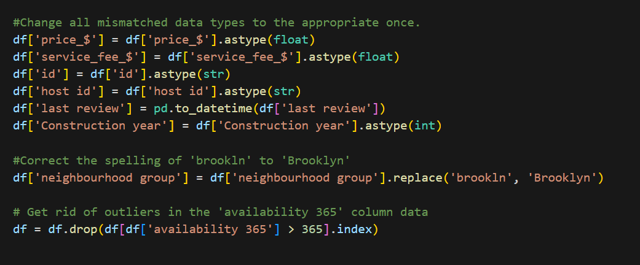
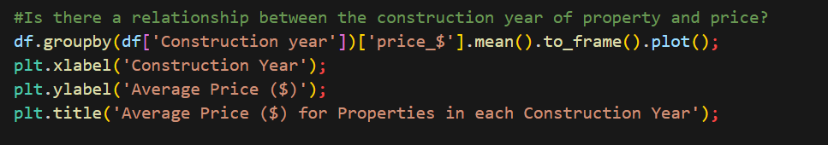
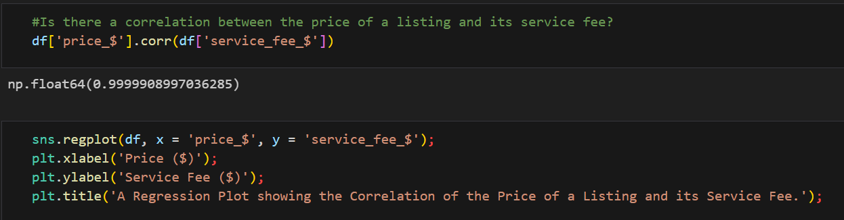
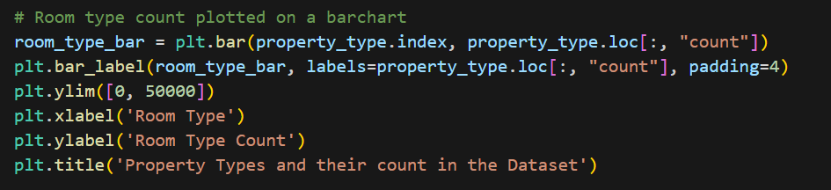
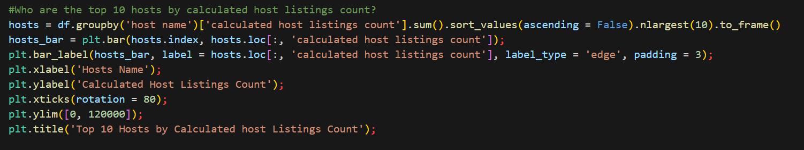
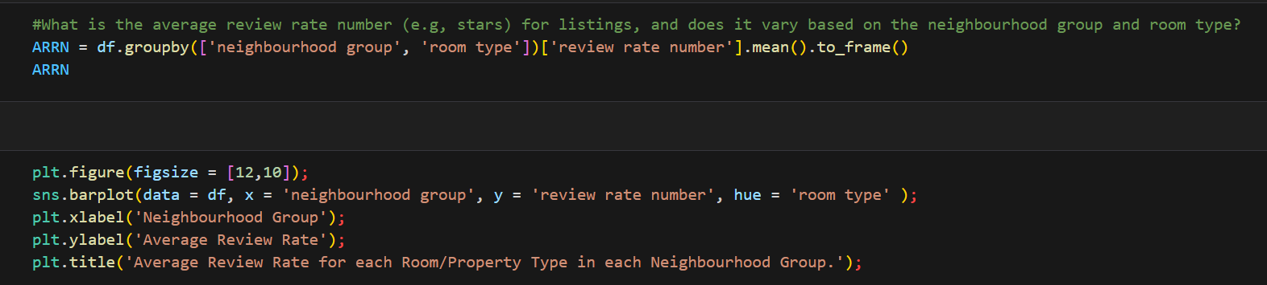
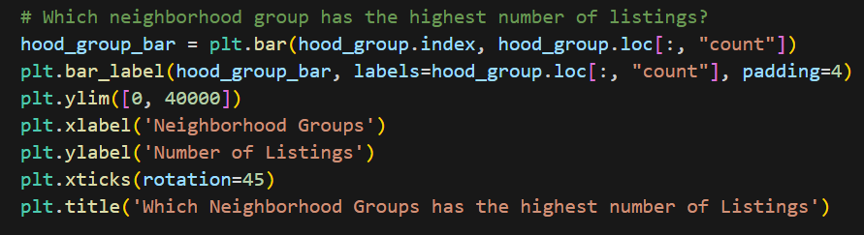
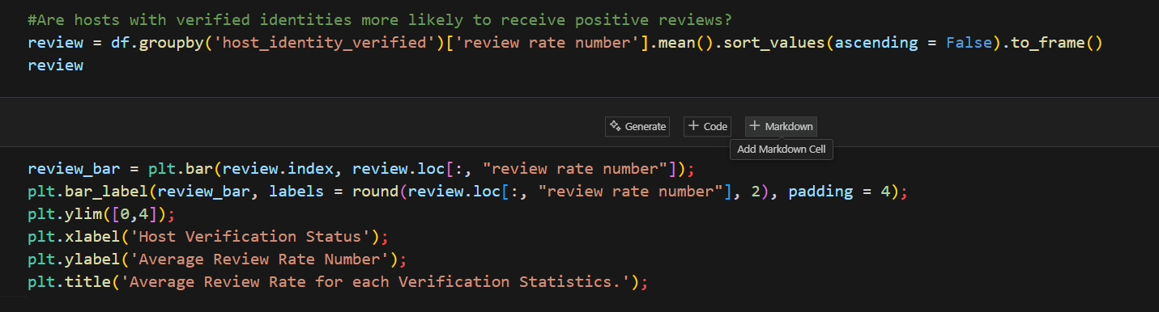
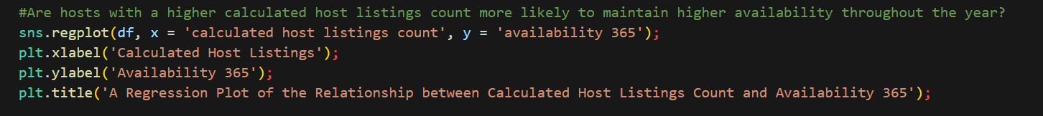
Python Code

Slide 7
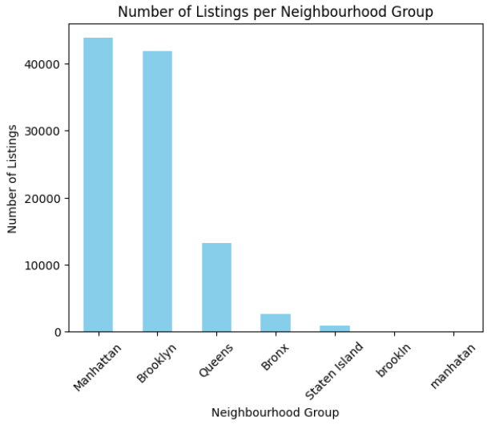
RESULTS 1

Slide 8
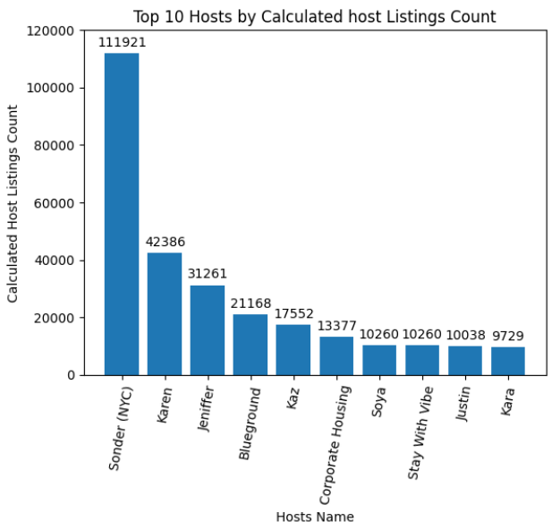
RESULTS 2

Slide 9
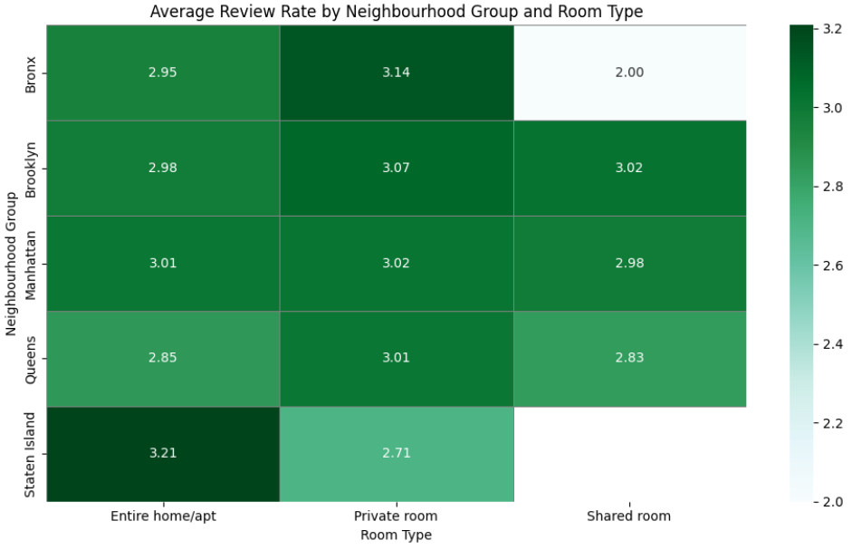
RESULTS 3

Slide 10
GitHub Repository
GitHub Link: sagar-shende/Airbnb-Hotel-Booking-Data-Analysis-

Slide 11

Getting started with Basics of Python Certificate

Slide 12
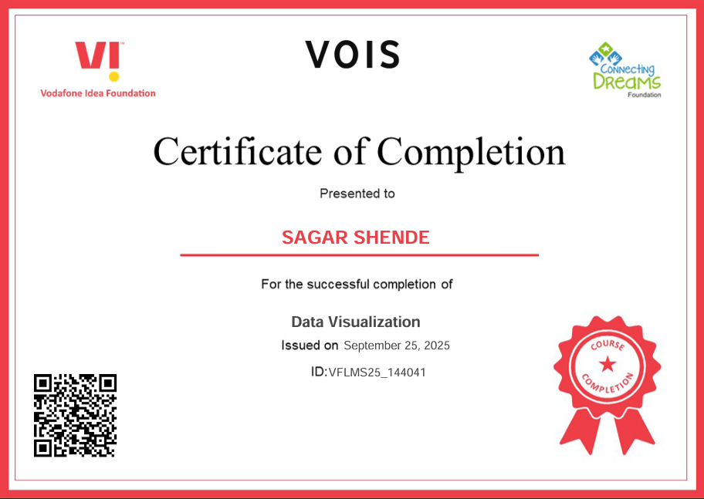
Data Visualization Certificate

Slide 13
Thank you
.
.

